Slide 1
Project Initiation & Planning

Slide 2
Project Charter & Statement of Work
The project charter is a document that outlines the primary project objectives and assigns roles and responsibilities.
The project charter helps the involved project managers and the stakeholders understand what the given project is supposed to accomplish.
It defines the project's scope, offers deadlines and milestones, and provides information on identified risks and the budget.
This document remains with you throughout the project's life cycle. You’ll be referring to it throughout, whether at meetings or to assist with scope management. The charter acts as a roadmap.
A project manager typically writes the project charter, however, it requires collaboration with different stakeholders to be a success

Slide 3

Project Charter & Statement of Work
Differences between Project Charter and SoW
Statement of Work
A detailed contract-style document that describes exactly what work will be performed and how deliverables will be produced.
SoW is a purely technical document prepared by the vendor, outlining the technical solution and the services the vendor is going to build or provide in a project.
SoW is used externally by the company.
Aspect | Project Charter | Statement of Work (SOW)
Level of Detail | High-level, summary | Very detailed, technical, and contractual
Prepared by | Project sponsor/initiator | Client (buyer) or jointly with the vendor
Focus | Why the project is done, who is involved | What will be delivered, how, when, and under what conditions
Formality | Internal project authorization | Often contractual (can be legally binding)
Timing | Created at project initiation | Created before execution or contracting

Slide 4
How to Write a Project Charter: Key Elements of a Project Charter
The project charter typically documents the following parts of the project:
State the Project Information
Project objectives and constraints
Key stakeholders
Risks identified
Benefits of the project
General overview of the budget
Success metrics

Slide 5
State the Project Information
This first section in your project charter is where you’ll include your project’s general information, such as:
Name,
Description
Project sponsor
Project manager
Team members, and
Stakeholders

Slide 6
Project objectives and constraints
Identify the constraints:
Budget: Limited financial resources
Time: Deadlines and milestones
Resources: Availability of skilled team members, tools, or technology
Stakeholder Requirements: Changing or conflicting expectations
Scope Limitations: Boundaries of what is included/excluded
Regulatory/Compliance Issues: Legal and policy constraints
Outline the main objectives of the project. These objectives should be SMART:
Specific
Measurable
Achievable
Realistic, and
Time-bound.

Slide 7
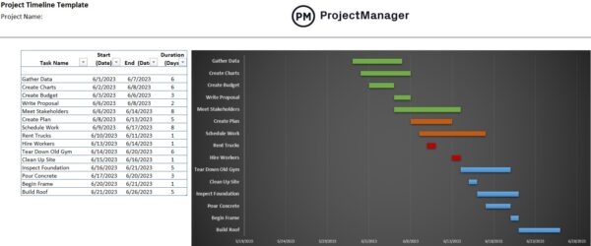
Project Timeline & Milestones
Define Start & End Dates
Establish official project kickoff date
Set project completion deadline
Identify Key Milestones
Major deliverables and checkpoints
Examples: Requirements finalized, Prototype completed,
Testing phase start, Go-live date
Breakdown Activities
Divide the project into phases and tasks
Assign estimated durations for each task
Create a Timeline
Use Gantt charts or milestone charts
Show dependencies between tasks
Dynamic Tracking
Input timeline into project management software (e.g., MS Project, Jira, Trello)
Update progress in real-time to monitor delays and bottlenecks

Slide 8
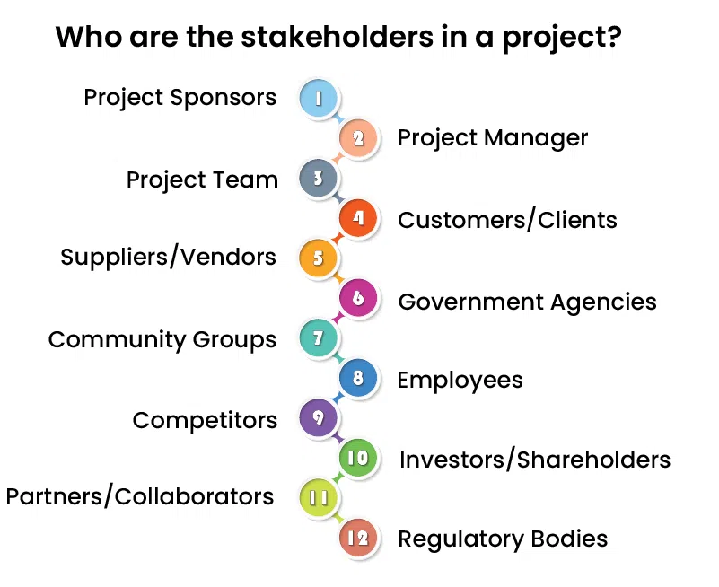
Key stakeholders
Identifying Stakeholders: Anyone who is affected by, involved in, or can influence the project’s success.
List All Stakeholders:
Internal: Project sponsor, project manager, development team, testers
External: Customers, vendors, regulators, end-users
Define Roles & Responsibilities:
Sponsor: Provides funding & overall support
Project Manager: Oversees execution
Team Members: Deliver tasks & outputs
End-users: Provide requirements & feedback
Identify Needs from Stakeholders:
Approvals, resources, requirements, expertise, feedback
Maintain Contact Information:
Emails, phone numbers, communication channels (Slack, Teams, etc.)

Slide 9
Log Key Project Risks
Types of Risks:
Technical Risks: System failures, integration issues
Resource Risks: Limited staff, skill shortages, budget cuts
Schedule Risks: Delays, scope creep, unrealistic deadlines
Stakeholder Risks: Changing requirements, low engagement
External Risks: Regulatory changes, vendor delays, market shifts
Risk Management Plan :
Identify: List potential risks early
Analyze: Assess probability and impact
Respond: Avoid, mitigate, transfer, or accept risk
Monitor: Continuously track risks and update the plan

Slide 10
Benefits of the project
Consider and describe how the project will positively impact:
Stakeholders
Customers.
End users
Be as specific as possible, as it’s important to keep the benefits in mind as you work through the project to prioritize effectively

Slide 11
General overview of the budget
According to PMI, Project management costs 7–11% of the total project budget
High-Level Financial Overview
Available Funds: Total approved budget
Anticipated Costs Breakdown:
Project Management (7–11%) – planning, monitoring, reporting
Human Resources – salaries, training, consultants
Technology & Tools – software licenses, hardware
Operations – facilities, utilities, travel, communication
Quality Assurance & Testing – validation, audits
Risk Reserves – contingency funds for unforeseen issues

Slide 12
Success Metrics
Success metrics provide measurable targets for project outcomes
Support performance monitoring and evaluation
Key Performance Indicators (KPIs):
On-time delivery of milestones
Staying within budget limits
Meeting quality standards (e.g., defect rates, compliance levels)
Customer/end-user satisfaction levels
Stakeholder engagement and approval
Other Metrics:
Team productivity and efficiency
Risk management effectiveness (resolved vs. open risks)
ROI (Return on Investment) or the business value achieved

Slide 13
Sample Project Charter for Website Development
Project Title: University Website Redesign
Project Purpose:
Redesign and develop the university website to improve user experience, accessibility, and responsiveness, while modernizing content management for staff.
Project Objectives (SMART):
Specific: Develop a responsive, accessible, and user-friendly website
Measurable: Achieve 95% user satisfaction in usability surveys
Achievable: Utilize existing IT team and CMS platform
Relevant: Supports university branding and digital presence
Time-bound: Complete redesign within 4 months
Scope:
In Scope: Homepage redesign, faculty pages, news & events, student portal integration, content migration, responsive design
Out of Scope: Third-party portal integration beyond the student portal, internal HR systems
Deliverables:
Fully functional website with modern UI/UX
Content migration from old website
Documentation & training for content management
Final project report
High-Level Timeline & Milestones:
Requirements Gathering: Month 1
Design & Prototyping: Month 1–2
Development & CMS Setup: Month 2–3
Testing & QA: Month 3
Deployment & Training: Month 4
Estimated Budget:
Total: $40,000 (design, development, content migration, testing, training, contingency)

Slide 14
Sample Project Charter for Website Development (cont..)
Project Team Members & Roles:
Project Manager: Web Project Lead – oversees execution, scheduling, and resources
Lead Developer: Senior web developer – supervises coding and integration
Front-end Developers: 2 members – build UI and responsive design
Back-end Developers: 2 members – implement server-side functionality
UI/UX Designer: 1 member – create design mockups and prototypes
QA/Testers: 2 members – functional, performance, and accessibility testing
Content Specialist: 1 member – content migration and review
Support Staff: 1 member – documentation, training, and coordination
End-users: Students, faculty, staff – provide feedback and accept deliverables
Constraints:
Budget limited to $40,000
Completion within 4 months
Limited availability of senior web designers
Assumptions:
Content will be provided on time by department heads
Hosting and domain services will be maintained during project
Success Metrics:
95% user satisfaction in usability surveys
Completion of website within project timeline and budget
Zero critical defects at deployment
At least 90% content migrated correctly
Positive stakeholder feedback post-launch
Approval Signatures:
Project Sponsor: _____________________
Project Manager: _____________________
Date: _____________________

Slide 15
Quizzes
A vendor is contracted to supply and install solar panels for a university campus. The document includes site details, technical specifications of the panels, warranty information, and payment terms.
A new software project has just been approved. The sponsor has asked for a document that identifies the project manager, objectives, high-level scope, and success criteria. Which document is this?
Your team is preparing a contract with an external vendor. The vendor wants clear details on project deliverables, payment terms, schedule, and acceptance conditions. Which document is required?
A government agency is launching a new project to digitize land records. The project sponsor requests a document that states the project’s purpose, names the project manager, and lists the major stakeholders. Which document is required?
Before project execution, the steering committee wants to see a document that shows who the sponsor is, what problem the project will solve, and the estimated high-level budget.

Slide 16
Assignment
Jira is a popular project management and issue-tracking tool. It is widely used in software development, especially in Agile environments, to plan, track, and manage projects efficiently.
Task 1: Explore Jira Basics
Task 2: Create a Sample Project
Create a new project (Scrum or Kanban).
Add at least 5 tasks/issues, assigning them to team members (can be fictional).
Set priorities (High, Medium, Low) and due dates.
Add descriptions for each task, defining acceptance criteria.
Task 3: Organize and Track Work
Create a sprint (if Scrum) or organize tasks on a Kanban board.
Move tasks through stages (To Do → In Progress → Done).
Monitor progress using Jira reports (Burndown chart, Sprint report, etc.).

